Slide 1
Video as Data: Technical and Social Aspects of a Collaborative Multimedia Application
(Nardi, Kuchinsky, Whittaker, Leichner, Schwarz, 1996)
Focuses on the ways that video can aid in teamwork (in a neurosurgery environment)
Beyond simply talking to one another, video enables analysis and problem solving.
  Must respond to needs of many positions in the hospital, and be able to allow people not only to monitor, but synthesize and interpret info.
Key issues:
  Video as data as opposed to talking heads
  New ways to make video a richer medium
  Uses for audio and visual channels
  Privacy problems
Notes:
We can talk a little bit about what is meant by “teamwork” later…
Emphasis on the MANY NEEDS of the hospital to do all three of those things (monitor, synth, interpret)

Slide 2
Video as Data
  Goal of video-as-data is use (video) access to the environment/context to coordinate both teamwork and education among various staff.
  Scrub nurses use live video (of surgery) in room to coordinate and anticipate.
    Use of info crosses temporal lines
    Use of info supplements prior knowledge
  Anesthesiologist uses live video in room to keep interested
    Alleviates boredom, but the shared awareness is also useful for coordinating
  Neurophysiologist uses remote feed of data from the environment in concert with live video of surgery
    Allows them to oversee multiple surgeries, while multitasking
    Allows them to decipher data responses better when seeing video
  Multiple “workspaces,” serving highly varied, but collaborative functions.
Notes:
Video as data clearly the most important of the experiments, so,
So we have two “workspaces” or videos-as-data…the surgery in microscope, and the video images of instrument data and images of the OR (and audio)
So these multiple workspaces are used in different ways by different professions:
Images can coordinate fast paced exchanges of insturmesnts, serve as means of maintainting focus, helps find correct interpretation, educates others
This allows the people to work independently, btu collaboratively, which is a very new take on what interpersona or collaborativel communication is made of… it is HIGHLY collaborative, but not interpersonal…individuals do their tasks, anticipate the needs of others, but the interaction is different. This finding calls into wuestion our norms of “sociality” or social engagement within collaborative tasks.
Process = collection of parts?? More than that??
It can become the topic of discussion and interaction--teaching, etc
Also calls into question of remoteness and colocation…the surgery is always remote (except for surgeon), so it’s the location of the environment, not the people that is important. does this mean that the bike repair in kraut is always remote for the helper, and the enviro was VERY remote b.c of weird headgear…how might that affect his theories about his findings.

Slide 3
Tools for video: Since video-as-data is so important, the tools for video must be updated.
Augmentations, annotations, and parsing
Specifically important for education:
  Synching up video of surgery with other (field specific) data sources, as was done in the hospital
    Practice and post hoc analysis
  Scrolling through data/video
  Finding particular data/video event
Audio vs. Video: Each have their own purposes:
What is said:
  Often, it’s easier to hear via remote audio
  Aids in understanding and anticipation (“beyond being there”)
Atmosphere/tone of OR
  The emotional tone of those in the room, and the surrounding noises change neurophysiologists’ behavior
Remote video gave statistical/hard data, audio gave emotive/soft data
  Audio does more than just carry words, and video can do more than just display events (if we help it!)
Notes:
Active engagement in edu must go beyond telling htem or simply replaying surgeries

Slide 4
Privacy (concerns with video use)
  With video comes an inherent REcontextualization of the events of the OR
    Calls into question lines between public/private behavior
    Changes the level of ephemerality
Fear of changes in behavior
  Effects for collaborative process within the OR
Fear of monitoring
  Big Brother and malpractice suits
Annoyance at modes of introducing the technology
  Questions of who was informed, and cursory justification
    In many ways, this is the opposite of other video CMC (not useful, but enjoyable), in terms of “they don’t like it, but it’s useful.”
  Do the solutions aptly cover problems raised, or just paper over political/professional divide?

Slide 5
Visual Information as Conversational Resource in Collaborative Tasks
(Kraut, Fussell, and Siegel, 2003)
Focuses on the role of visual info in maintaining task awareness and in achieving mutual understanding
Collaborative tasks focus on:
  Identifying target objects
  Describing actions to be performed on targets
  Confirming actions have been executed.
These require coordination, and visual info does that in two ways…
Notes:
All collaborative tasks focus on these 3 functions (Iding, describing, confirming)

Slide 6
Situational Awareness:
  Defined as: “Up to date mental models of the state of the task and others’ activities.”
Common Grounding:
  Gained by being members of the same “group,” through linguistic co-presence, or through physical co-presence.
    Visual information as similar form of presence, so if we give a “worker” a bike to fix, a visually- present (and situationally aware) “helper” should be able to aid in grounding and in performing physical tasks.
Notes:
The two ways we can coordinate our actions to become collaboration are sit awareness and common grounding (a theory we’ve become well accostomed to now)
After def: ie the state of an object, the actors engagement with the object, the actions taken involving the object, and the way those actions change the object and the actor.
Group--learn same lang
Ling co--hear same lang in context, so learn
Physical--see same events, some degree of back and forth possible between these last two

Slide 7
Experiment 1 (video vs. audio help)
Attempt to see how visual information:
  Affects/aids mentoring tasks taking complex coordination (fixing the bike)
    Task performance = #of tasks, completion time, repair quality
      Access to an expert helped, better communication tools had no effect.
  Affects the conversation about the task
    Explicitness of worker’s descriptions
      More explicit when no visual info available--and in describing their own state (“uh-huh”)
      Experts treated workers descriptions differently
    Value of helper’s instructions
      More instruction when worker can be seen
Notes:
So there were two experiments involving putting a bike together with the help of a remote instructor. The helper could see the hands of the worker via a headcam, so space of environment is a special issue. Also, the worker couldn’t see the helper at all.
The first was audio vs. video help, and they measured task completion, and conversation about the bike

Slide 8
Experiment 2 (video vs. audio vs. side-by-side)
Task Performance
  Side by side = 25% faster
  Visual info received via video influenced dialogue, but didn’t improve performance.
Conversational Grounding
  - Side by side =more efficient (fewer utterances, less acknowledgement)
Deixis
  Side by side had most.
  In video, there may have been major reasons there was a lack of deictic expressions
    Workers did use deictic expressions, but helpers did not (based on shared environment).
    Also had to negotiate what “shared environment” was.
Notes:
The second experiemnt, they modified a little…this one had audio v video v sidebyside, same environmental conditions, but it measured slightly different things too.
For performing the task, they again used tasks ot mean speed of repair
For grounding, there were fewer a
For deixis, that means opinting gesutres
Sooo co presence is best, biggest benefit being the extensive shared environment (raises question of is the visual space the same as a co-present space? Can it be?) and also raises questions about how we think about space, and its relation to context that may not be visual (since the “space” at hand supplied by the headcam wasn’t a very good model for giving the necessary contextual space.)

Slide 9
Gutwin, C., and Greenberg S. (2001) A Descriptive Framework of Workspace Awareness for Real-Time Groupware. Computer Supported Cooperative Work, Kluwer Academic Press.
Goals:
Develop Framework for Workspace Awareness
Support the design of groupware systems
Hypothesize that enabling awareness will increase performance
What is Workspace Awareness?
“Knowing what is going on”
Up-to-the-moment understanding of another person’s interaction with a shared workspace.
Perception-Action cycle: individuals constantly perceiving and interpreting information
Why is Workspace Awareness Difficult in Groupware?
Reduced availability of perceptual information
Interactions are more limited and less informative
Systems do not present the data that is available

Slide 10
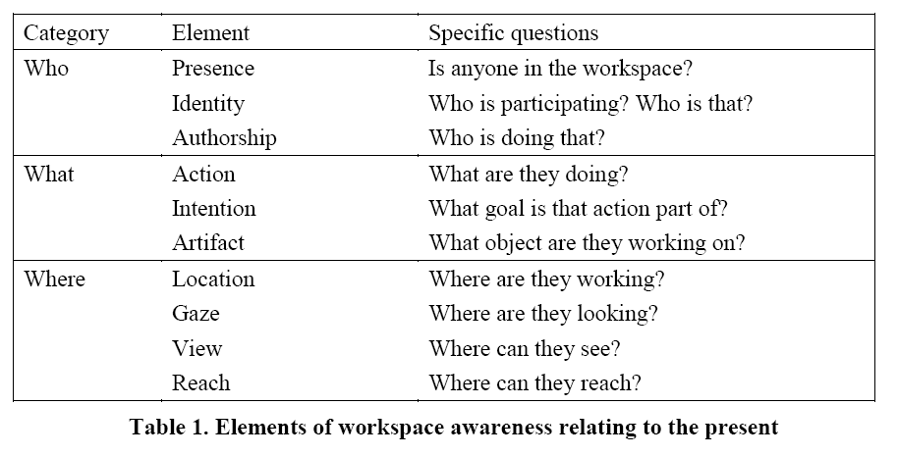
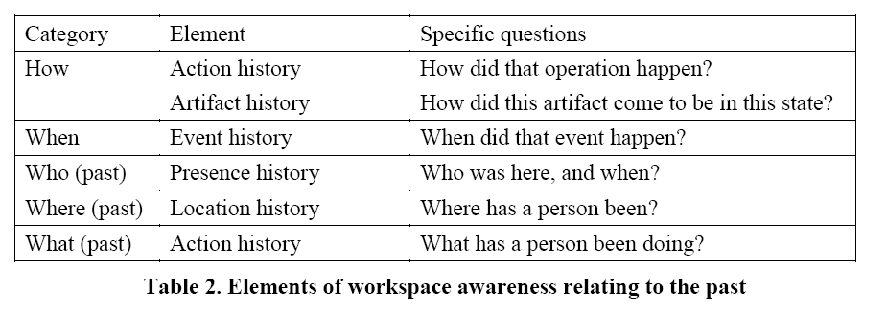
Gutwin, C., and Greenberg S. (2001) A Descriptive Framework of Workspace Awareness for Real-Time Groupware. Computer Supported Cooperative Work, Kluwer Academic Press.
Framework Part 1: Elements of W.A. Knowledge

Slide 11
Gutwin, C., and Greenberg S. (2001) A Descriptive Framework of Workspace Awareness for Real-Time Groupware. Computer Supported Cooperative Work, Kluwer Academic Press.
Framework Part 2: Mechanisms to Maintain W.A.
Consequential Communication
  Passive results of other people’s bodily actions
Feedthrough
  Intercepting feedback that others receive from the environment
Intentional Communication
  Explicit conversation
  Monitoring of others conversation

Slide 12
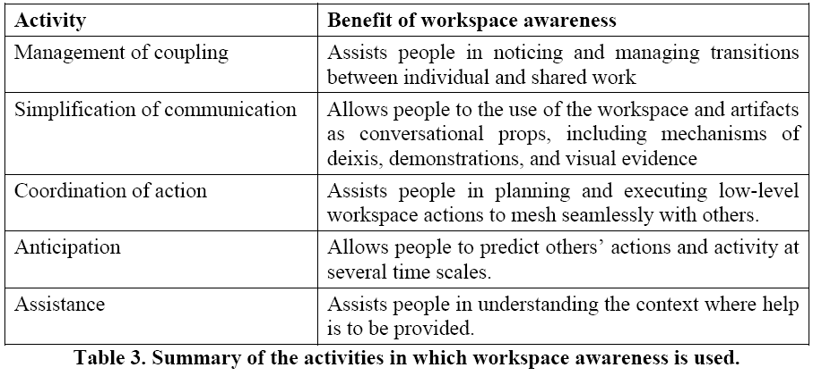
Gutwin, C., and Greenberg S. (2001) A Descriptive Framework of Workspace Awareness for Real-Time Groupware. Computer Supported Cooperative Work, Kluwer Academic Press.
Framework Part 3: How W.A. is used in Collaboration
Three Primary Benefits
  Reduce Effort
  Increase Efficiency
  Reduce Errors

Slide 13
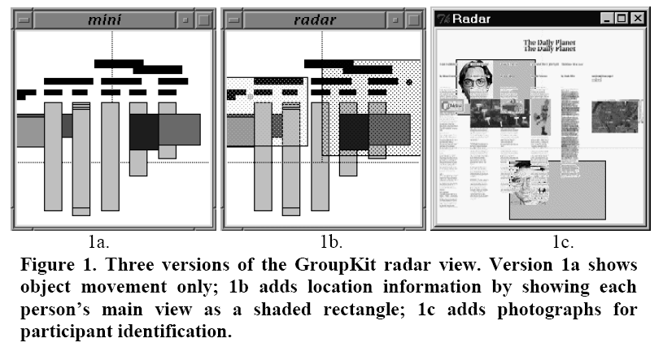
Gutwin, C., and Greenberg S. (2001) A Descriptive Framework of Workspace Awareness for Real-Time Groupware. Computer Supported Cooperative Work, Kluwer Academic Press.
Applications for Interface Design
Posits that understanding of W.A. can inform interface design.
  Situated Placement, Literal Presentation
  Radar View

Slide 14
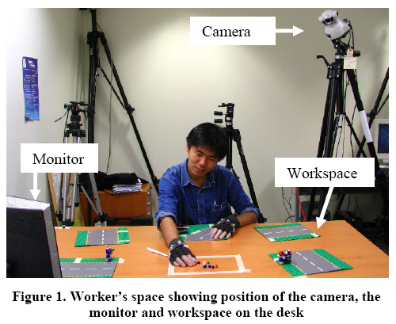
Ranjan, A., Birnholtz, J. P., & Balakrishnan, R. (2007). Dynamic shared visual spaces: Experimenting with automatic camera control in a remote repair task. Proceedings of CHI 2007 (pp. 1177-1186). ACM Press.
Overview:
Recognizes Trade-off: Overview vs. Detail – Passive vs. Active
Develop and Test the effects of an automatic camera control system in worker-helper Lego construction task

Slide 15
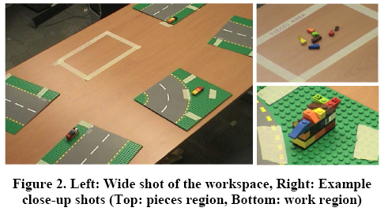
Ranjan, A., Birnholtz, J. P., & Balakrishnan, R. (2007). Dynamic shared visual spaces: Experimenting with automatic camera control in a remote repair task. Proceedings of CHI 2007 (pp. 1177-1186). ACM Press.
Study Design:
  Camera
    Static vs. Automatic

Slide 16
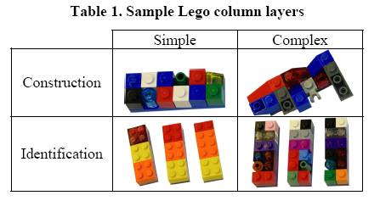
Ranjan, A., Birnholtz, J. P., & Balakrishnan, R. (2007). Dynamic shared visual spaces: Experimenting with automatic camera control in a remote repair task. Proceedings of CHI 2007 (pp. 1177-1186). ACM Press.
Study Design:
  Task Complexity
    Low vs High

Slide 17
Ranjan, A., Birnholtz, J. P., & Balakrishnan, R. (2007). Dynamic shared visual spaces: Experimenting with automatic camera control in a remote repair task. Proceedings of CHI 2007 (pp. 1177-1186). ACM Press.
Hypotheses:
  Participants in the Automatic Condition will:
  Work Faster (H1)
  Have Less errors (H2)
  Receive greater benefit for higher complexity (H3)
  Greater Satisfaction (H4),
  Value detailed views over awareness of the partner (H5)
  Communication structure will:
  Have less direct interaction with the camera (H6)
  Differing use of Dominant/non-dominant hands in different conditions (H7)

Slide 18
Ranjan, A., Birnholtz, J. P., & Balakrishnan, R. (2007). Dynamic shared visual spaces: Experimenting with automatic camera control in a remote repair task. Proceedings of CHI 2007 (pp. 1177-1186). ACM Press.
Findings:
No main effects for camera condition (fails H1)
Interaction found between task complexity and camera condition on completion time (supports H3)

Slide 19
Ranjan, A., Birnholtz, J. P., & Balakrishnan, R. (2007). Dynamic shared visual spaces: Experimenting with automatic camera control in a remote repair task. Proceedings of CHI 2007 (pp. 1177-1186). ACM Press.
Findings:
Errors:
  Less hand movements per minute in Automatic condition
(Supports H2)
Perceived Performance:
  Indiv perceived better in automatic condition (H4)
  But pair performance not better
Communication Process
  Helpers resorted to verbal description in wide view (H5)
  Less vertical movement in automatic (showing pieces to camera) (H6)

Slide 20
Ranjan, A., Birnholtz, J. P., & Balakrishnan, R. (2007). Dynamic shared visual spaces: Experimenting with automatic camera control in a remote repair task. Proceedings of CHI 2007 (pp. 1177-1186). ACM Press.
Discussion:
System has positive impact
  more effective in lexically complex tasks (Gergle)
Source of benefits
  Looser coupling to the helper
  Less effort for both helper and worker
    Easy to learn
    Allows for adaptation

Slide 21
Erickson, T. and Kellogg, W.A. (2000) Social Translucence: An Approach to Designing Systems that Support Social Processes. ACM Transaction on Computer-Human Interaction, 7(1) 59-83
Socially Translucent Systems:
Digital systems that support coherent behavior by making participant and their activities visible to one another
Visibility (The Door)
  Awareness – I know you’re there
  Accountability – I know you know I know you’re there
Constraints/Translucence (The Editing Room)
  Awareness – I am aware of activity around me
  Accountability – I can’t be held accountable if I’m not there
  Privacy Issues

Slide 22
Erickson, T. and Kellogg, W.A. (2000) Social Translucence: An Approach to Designing Systems that Support Social Processes. ACM Transaction on Computer-Human Interaction, 7(1) 59-83
Proposed System:
Knowledge Communities: designed with from a social perspective to support the discovery, use and manipulation of knowledge. These need to support Conversation:
  Activity support:
    enable long running deep conversations amongst participants. Knowledge can be embedded in these conversations
  Conversation Visualization and Restructuring:
    Searchable and Navigable, increase access and awareness of conversations. Also add to structure of conversations
  Organization Knowledge Spaces:
    handle the tradeoff between privacy and visibility through semi-visibility.

Slide 23
Erickson, T. and Kellogg, W.A. (2000) Social Translucence: An Approach to Designing Systems that Support Social Processes. ACM Transaction on Computer-Human Interaction, 7(1) 59-83
Implementation of Visibility:
  Realist (Video),
  Mimetic (Graphical MUD),
  Abstract approachs (Babble)
Abstract approach over a Realist or Mimetic approach
  Scales well
  Text is easy to produce and manipulate
  Persistence

Slide 24
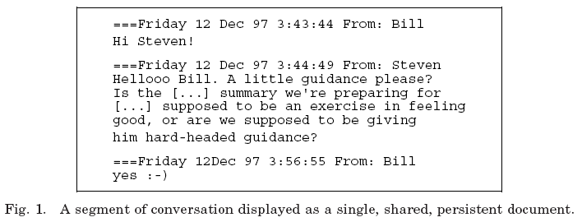
Erickson, T. and Kellogg, W.A. (2000) Social Translucence: An Approach to Designing Systems that Support Social Processes. ACM Transaction on Computer-Human Interaction, 7(1) 59-83
Babble:
  Persistent text conversation
    Supports emergence of conversational norms (through visibility, awareness, and accountability)

Slide 25
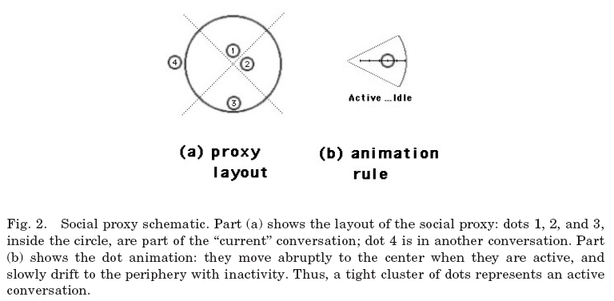
Erickson, T. and Kellogg, W.A. (2000) Social Translucence: An Approach to Designing Systems that Support Social Processes. ACM Transaction on Computer-Human Interaction, 7(1) 59-83
Babble:
  Synchronous activity representation
    Social proxy
      Shows Size of audience
      Amount of activity

Slide 26
Erickson, T. and Kellogg, W.A. (2000) Social Translucence: An Approach to Designing Systems that Support Social Processes. ACM Transaction on Computer-Human Interaction, 7(1) 59-83
Issues:
What should be visible?
  Private chats?
  Longitudinal view of conversation?
How to support Coherence?
  Do social proxies support accountability for breaking norms through visibility?
  Different forms for different contexts? (lecture forms)
Browsability?
  How do we support search for new users?
  Knowledge access within organizations?

